Slide 1
Merging and Splitting Eigenspace Models
Tae-Kyun Kim
Senior Lecturer
https://labicvl.github.io/
T-K. Kim, B. Stenger, J. Kittler and R. Cipolla, Incremental Linear Discriminant Analysis Using Sufficient Spanning Sets and Its Applications, International Journal of Computer Vision, 91(2):216-232, 2011.
Merging and splitting eigenspace models, P Hall, D Marshall, R Martin, IEEE Trans. on PAMI, 22 (9), 1042-1049, 2000.

Slide 2
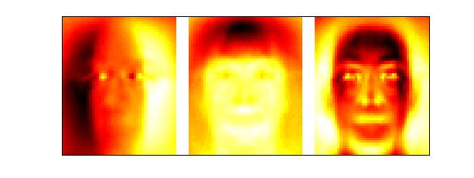
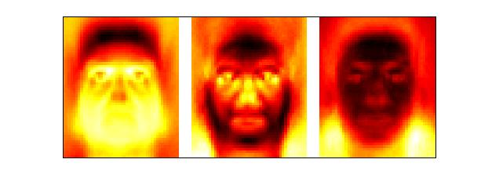
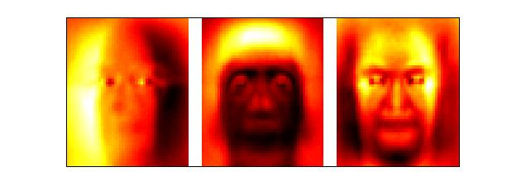
Dynamically updating eigenspace
Eigenspace models have a wide variety of applications, such as classification for recognition systems.
In practice, we need to build the engenspace models for numerous images: those images may not be given all initially, but incrementally.
Our goal is to dynamically update the eigenspace models, when new data entries are given or existing data points are removed.
The mean also needs to be updated.
1
2
3
P1
P2
P3

Slide 3
Incremental PCA
Batch vs Incremental
In batch computation: all observations are used simultaneously to compute the eigenspace model.
In incremental computation: an existing eigenspace model is updated using new observations.
Requirements: methods need to
handle a change in the mean.
add multiple new observations than exactly one observation at a time.
Pros and Cons
Benefits: an incremental method
does not need all observations at once - thus, reducing storage requirements and making large problems feasible.
Even if all observations are available, is usually faster to compute a new eigenspace model by incrementally than by batch computation.
Disadvantage: is their accuracy compared to batch methods. When only a few incremental updates are made, the inaccuracy is small.

Slide 4
Merging and splitting eigenspace models
We learn a deterministic method that given two eigenspace models - each representing a set of N-dimensional observations - will:
Merge the models to yield a representation of the union of the sets,
Split one model from another to represent the difference between the sets.

Slide 5
Eigenspace models and notations
For a set of M data vectors, x ∈ R^{N}, the covariance matrix is
where μ is the data mean.
PCA decomposes the covariance matrix s.t.
where P, Λ are the matrices containing the first d eigenvectors and eigenvalues.

Slide 6

Incremental PCA
Problem setting:
Input : given two sets of data represented
by eigenspace models
Output : compute the eigenspace model
of the combined data
The combined mean is obtained as
The combined covariance matrix is
where {Ci }, i=1,2 are the covariance matrices of the first two sets and
M3 =M1 +M2.
1
2
3

Slide 7
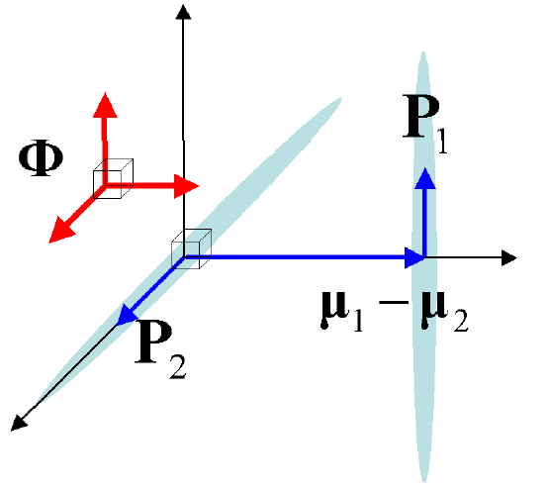
Incremental PCA
The eigenvector matrix P3 can be represented as
where,
is the orthonormal matrix spanning
the combined covariance matrix
i.e. the sufficient spanning set,
R is a rotation matrix, and
h is an orthonormalization function
followed by removal of zero vectors.

Slide 8
Incremental PCA
Using this representation, the eigenproblem is converted into a smaller eigenproblem as
By computing the eigendecomposition on the r.h.s. Λ3 and R are obtained as the respective eigenvalue and eigenvector matrices.
d1+d2+1
d1+d2+1

Slide 9
Incremental PCA
The eigenvector matrix to seek is given as
Note the eigenanalysis on the r.h.s. only takes computations
Where d1, d2 are the number of the eigenvectors stored in P1 and P2.
The eigenanalysis in a batch mode on the l.h.s. requires

Slide 10
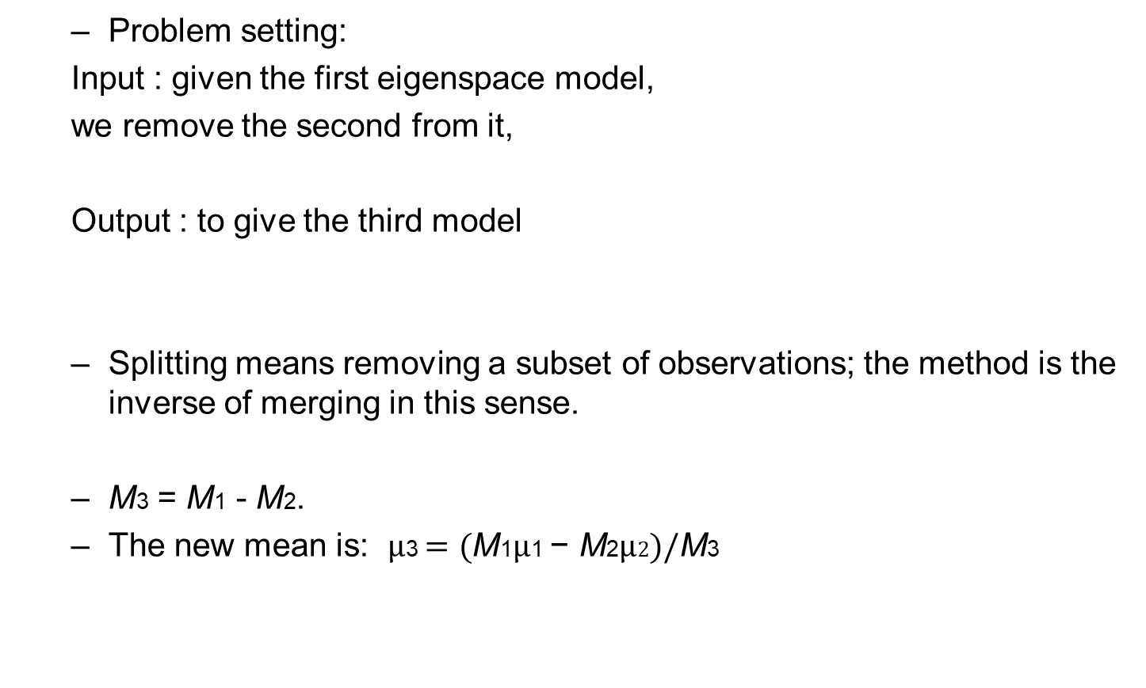
Splitting eigenspace models
Problem setting:
Input : given the first eigenspace model,
we remove the second from it,
Output : to give the third model
Splitting means removing a subset of observations; the method is the inverse of merging in this sense.
$\text{M}\text{3}$ = $\text{M}\text{1}$ - $\text{M}\text{2}$.
The new mean is: $µ\text{3}=(\text{M}\text{1}µ\text{1} \text{−} \text{M}\text{2}µ2)/\text{M}\text{3}$
1
2
3

Slide 11
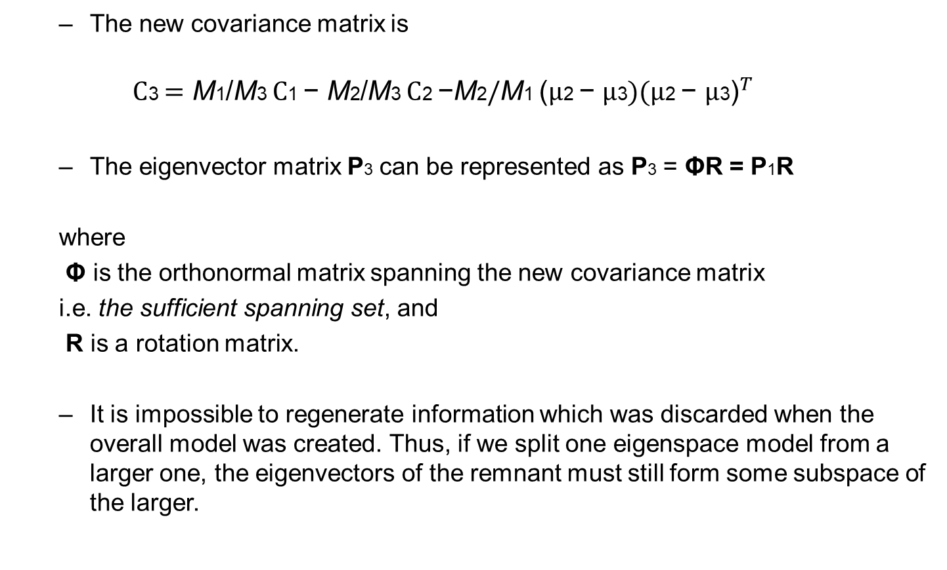
Splitting eigenspace models
The new covariance matrix is
$$C\text{3}={\text{M}\text{1}\text{/}\text{M}\text{3 }C\text{1 }\text{−} \text{M}\text{2}\text{/}\text{M}\text{3 }\text{C}\text{2 }\text{−}\text{M}\text{2}\text{/}\text{M}\text{1} \text{(}µ\text{2 }\text{−} µ\text{3})(µ\text{2} \text{−} µ\text{3}\text{)}}^{T}$$
The eigenvector matrix P3 can be represented as P3 = ΦR = P1R
where
Φ is the orthonormal matrix spanning the new covariance matrix
i.e. the sufficient spanning set, and
R is a rotation matrix.
It is impossible to regenerate information which was discarded when the overall model was created. Thus, if we split one eigenspace model from a larger one, the eigenvectors of the remnant must still form some subspace of the larger.

Slide 12
Splitting Eigenspace Models
Using this representation, the eigenproblem is converted into a smaller eigenproblem as
By computing the eigendecomposition on the r.h.s. Λ3 and R are obtained as the respective eigenvalue and eigenvector matrices.
The eigenvector matrix to seek is given as P3 = ΦR = P1R
d1
d1

Slide 13
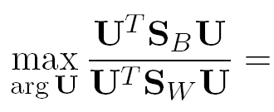
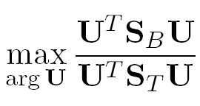


Experiments
Similarly, we can compute LDA (Linear Discriminant Anlysis) incrementally.
We apply the sufficient spanning set approximation in each update step, i.e. for the between-class scatter matrix, the toal scatter matrix and the projected data matrix:
By sufficient spanning sets

Slide 14
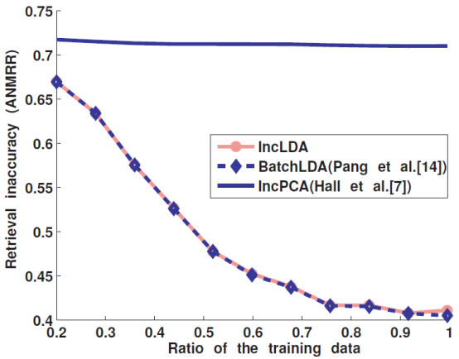
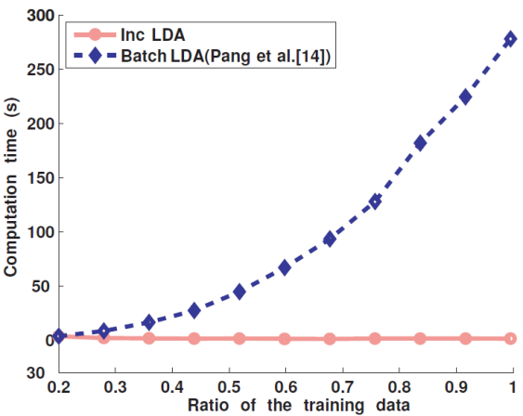
Experiments
MPEG7 face image datasets of 6370 images

Slide 15
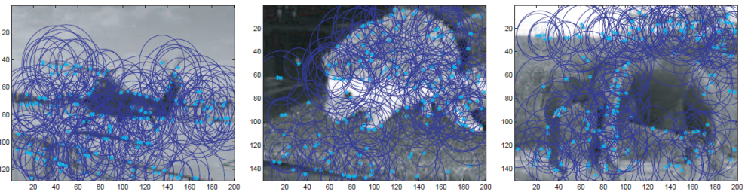
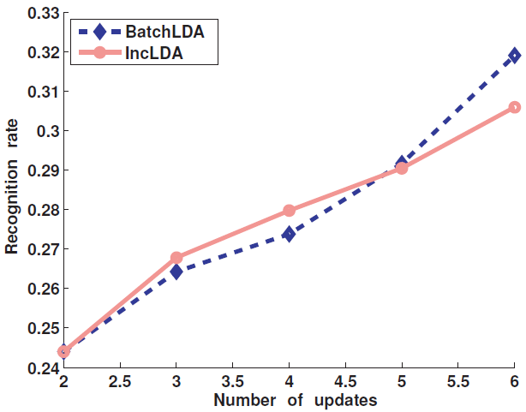
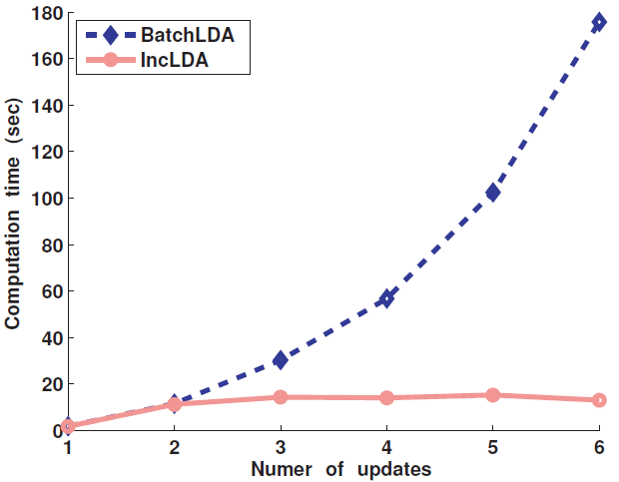
Experiments
Caltech101 datasets (using BoW representations), up to 800 images per category

